Slide 1
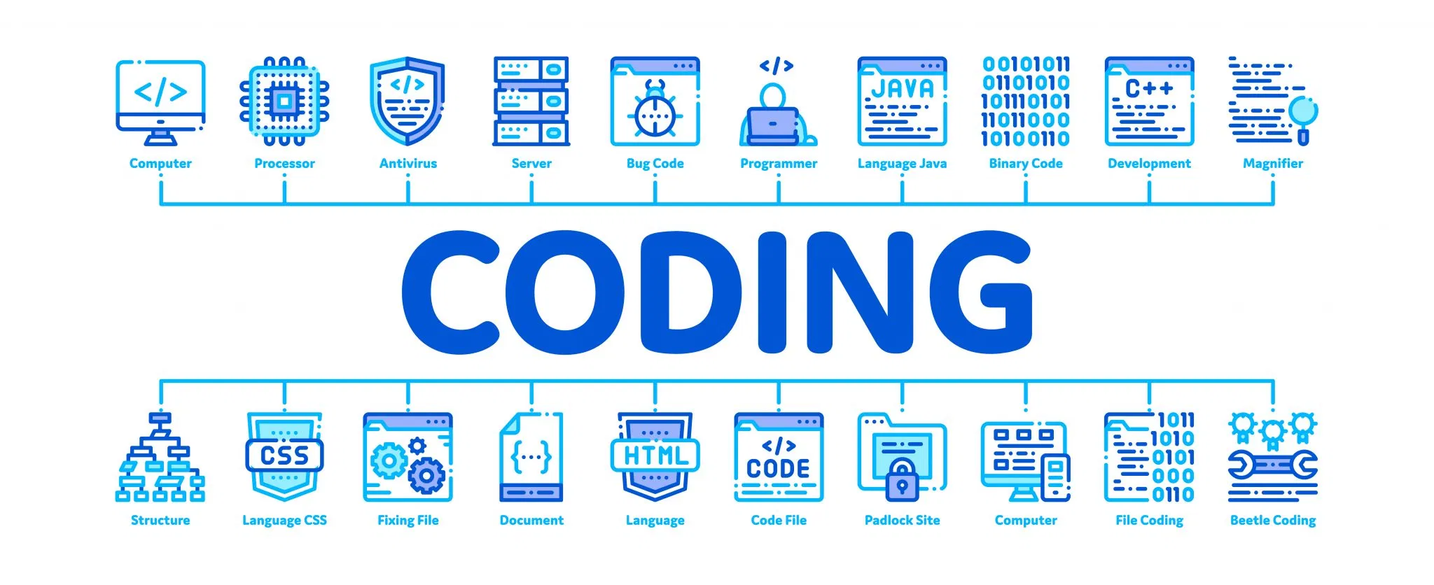
Topic 4
Introduction to Java

Slide 2
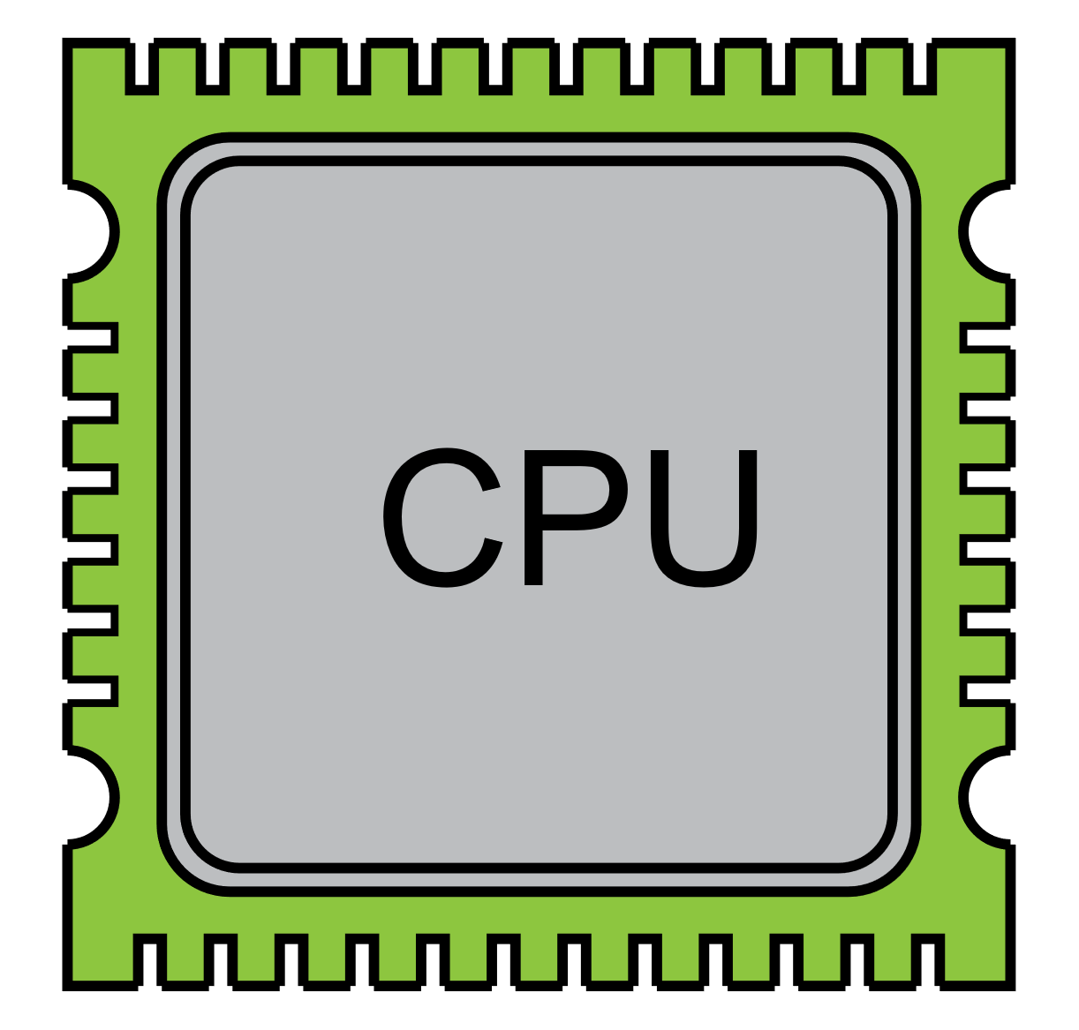
Let’s remember computers process information in binary
1
0

Slide 3

3
2
1
05
03
A1
4
ADD
opcode
0x03
0xA1
Result
0xA4

Slide 4
Programming Languages Generations
Specialized programming languages
Assembly language
1st gen
3rd gen
5th gen
2nd gen
4th gen
Machine Language
High Level programming languages
Artificial Intelligence Programming Languages

Slide 5
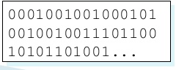

1GL (First Generation Language)
Machine language
All coding is done in binary. Code is not easily legible to human beings.
Zero or no abstraction. Tightly coupled to the hardware
A programmer must be an expert in hardware and software
1st gen

Slide 6
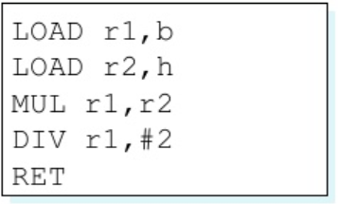
2GL (Second Generation Language)
Assembly language
Low level of abstraction
Code can be understood by programmers. Instructions are written using mnemonics (instead of opcodes)
For example: LOAD, MUL, DIV, etc.
2nd gen

Slide 7
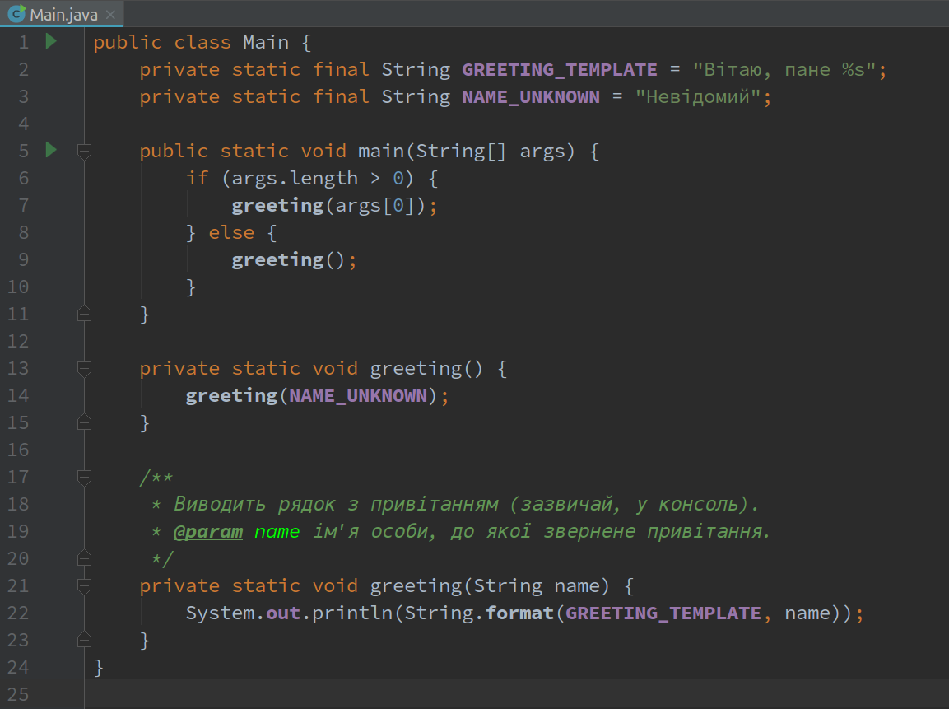
3GL (Third Generation Language)
High-level programming language
High level of abstraction, with instructions or phrases in english to represent instructions
High portability (same code can be executed in different devices)
Java, C++, C#, Python
3th gen

Slide 8
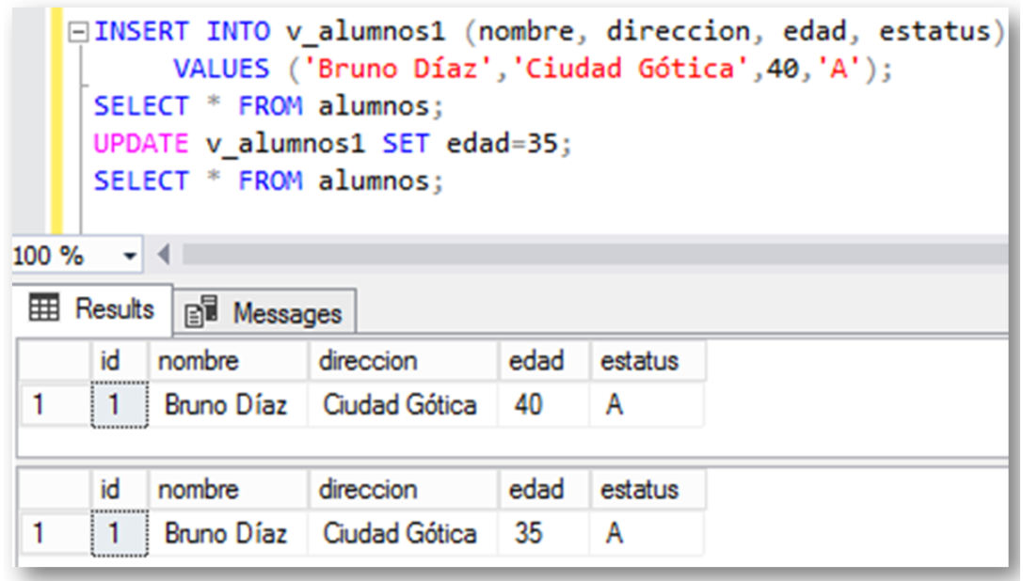
4GL (Fourth Generation Language)
Specialized programming language, also known as domain specific
Very specialized programming languages, with the objective to accelerate complex program design
Very high level of abstraction, with simple integration to other components (databases, APIs, frameworks).
SQL, ABAP, MATLAB, LabView
4th gen

Slide 9
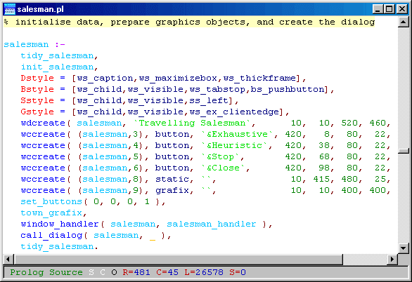
5GL (Fifth Generation Language)
5GL solves problems by defining a set of rules.
The programming language can design algorithms through AI, complex programming, etc.
5th gen

Slide 10
What is Java?

Slide 11
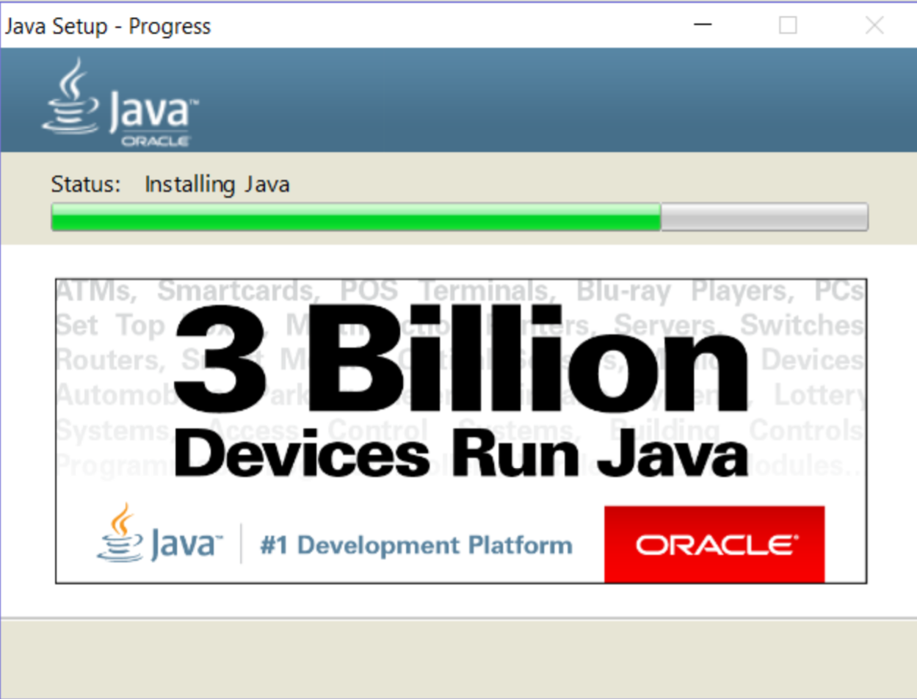

Slide 12
What is Java?
Java is a high-level programming language that runs on top of the Java Virtual Machine (JVM). Its main strengths are:
Cross-platform (programs can run on Windows, Mac, Linux, iOS, Android, and almost any modern platform)
Wide-spread, you can develop any type of application: mobile apps, web, video games, backend software, web services, APIs, etc.
Strong Object-Oriented Programming fundamentals
Many similarities to other programming languages
It is an excellent first programming language.

Slide 13


Slide 14

Clases
Java programs are called classes. To execute a class, we must first compile it. This is done by the compiler.
The java compiler takes a source code file (with the .java extension) and converts it into a bytecode file (with the .class extension).
Source File
Bytecode file
Compilador
MyProgram.java
MyProgram.class

Slide 15
Compiler
Compilers are programs that translate source code into something the computer can understand and execute.
Compilers vary vastly in complexity and functions across programming languages, but for Java, the compiler takes care of the following functions:
Reads source code file (or sometimes many files).
Verifies the consistency of the code, through lexical, semantic, and syntactic validations.
Generates bytecode files.

Slide 16
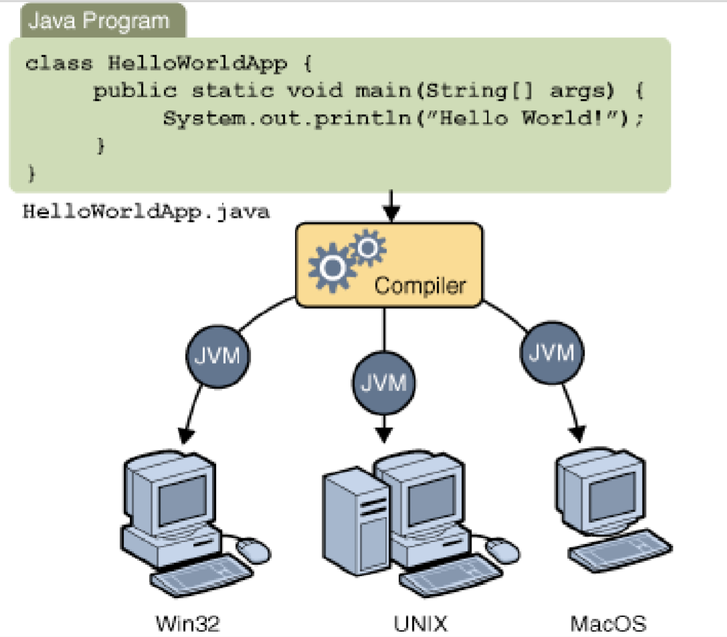

Slide 17
Java Virtual Machine (JVM)
Java runs on top of an execution environment called the Java Virtual Machine (JVM).
When running any Java-based program, the JVM is loaded into RAM.
Extract the bytecode (.class) and interpret it depending on the platform it is running on (Android, Windows, Mac, Linux, etc.)
Ensures bytecode is secure.
¡Run the programs!

Slide 18
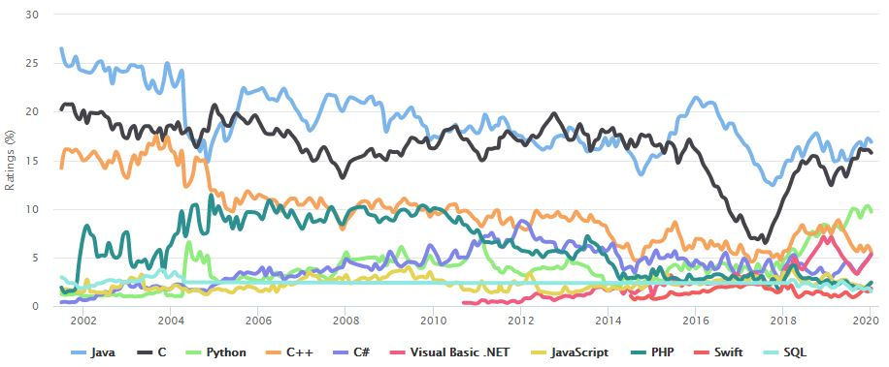
TIOBE Rating

Slide 19
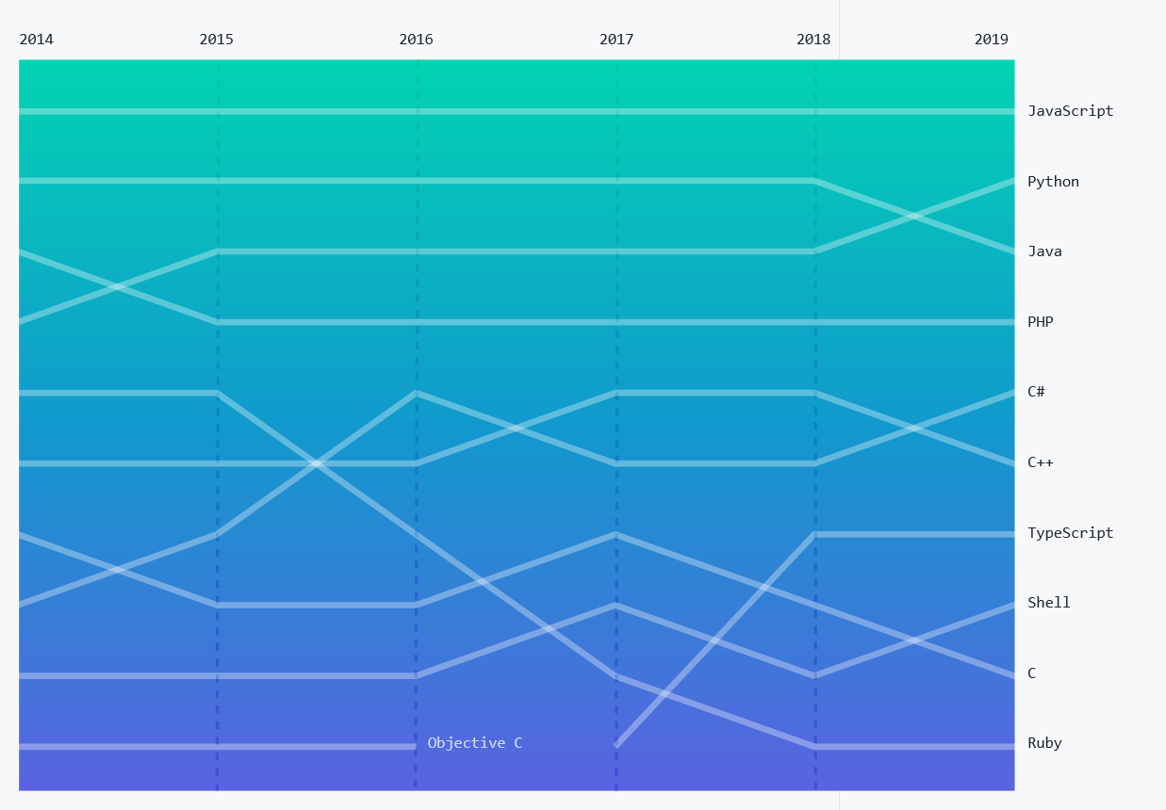
Github’s Octoverse Rating

Slide 20
Before we begin…
Code is very strict with syntax and spelling mistakes.
“It is a goood day“. ¡We understand this! Computer’s don’t.
UPPER and lowercase make a difference.
Spacing and identation is flexbile

Slide 21
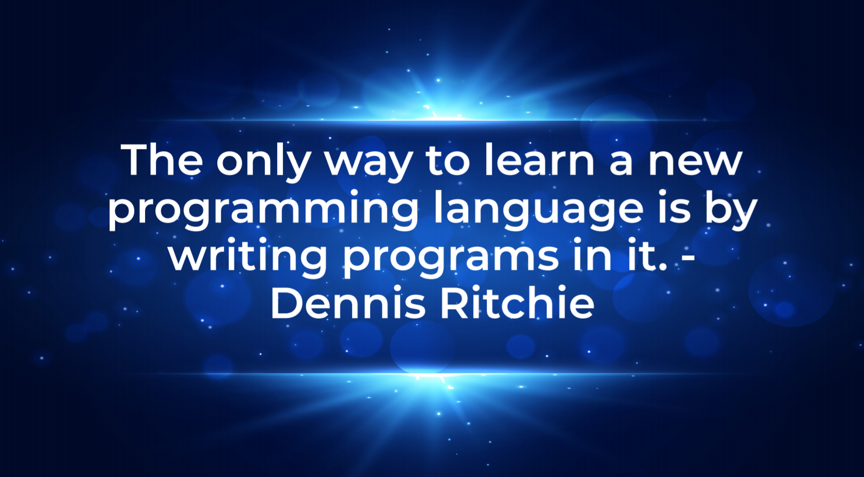

Slide 22
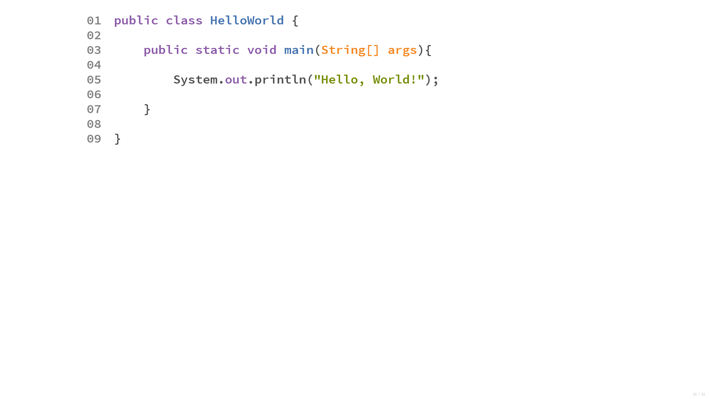

Slide 23
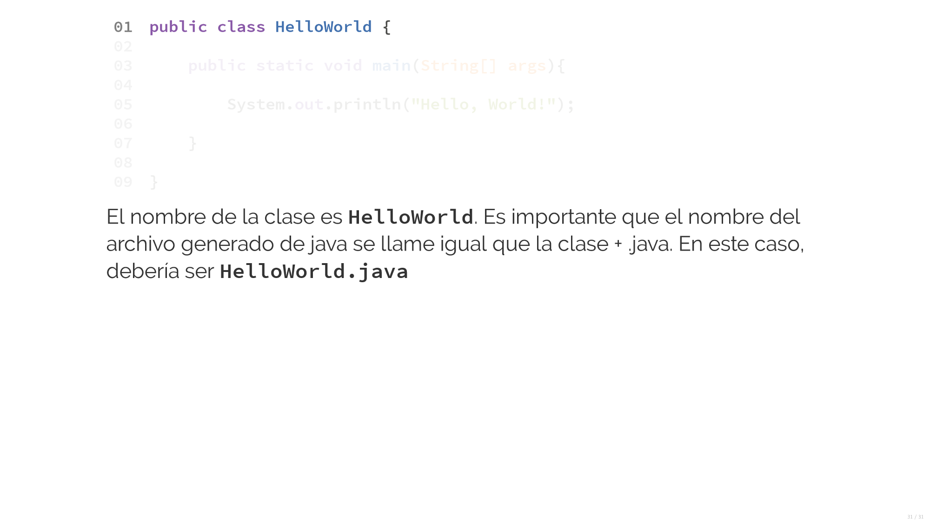
Class name is HelloWorld. The filename should also be called by its class name + “.java”
In this case, it would be HelloWorld.java.

Slide 24
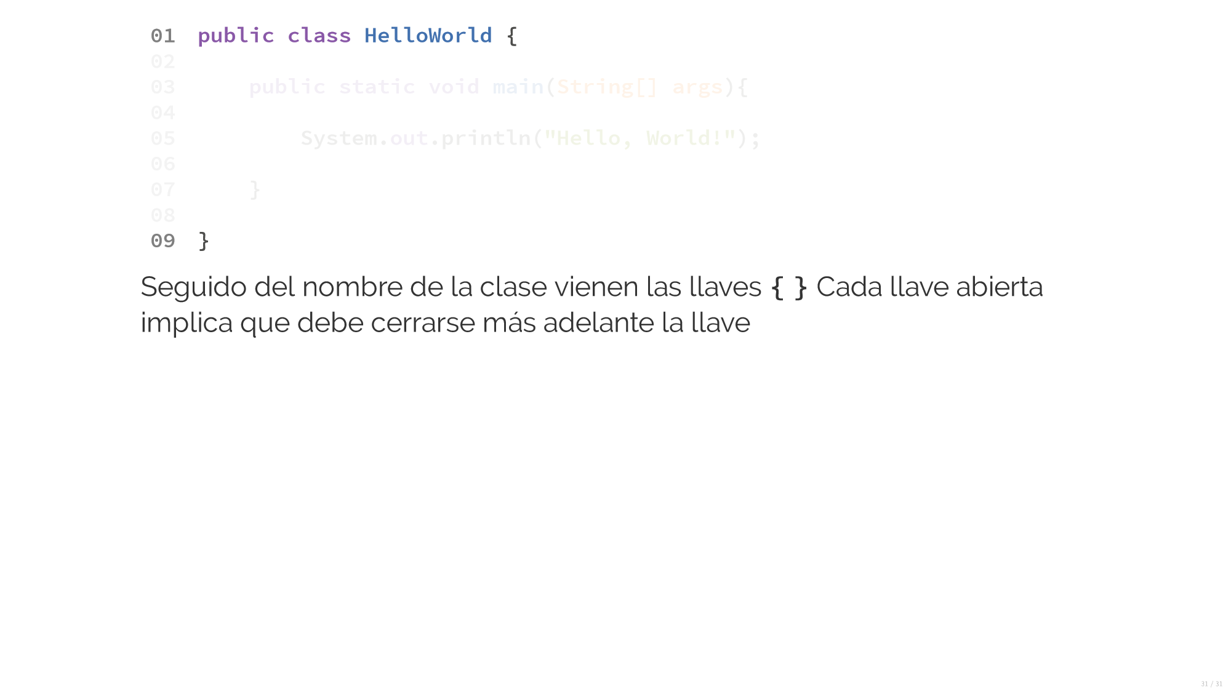
All the class code would be found between the brackets { }. Anything before or after is not part of the class.

Slide 25
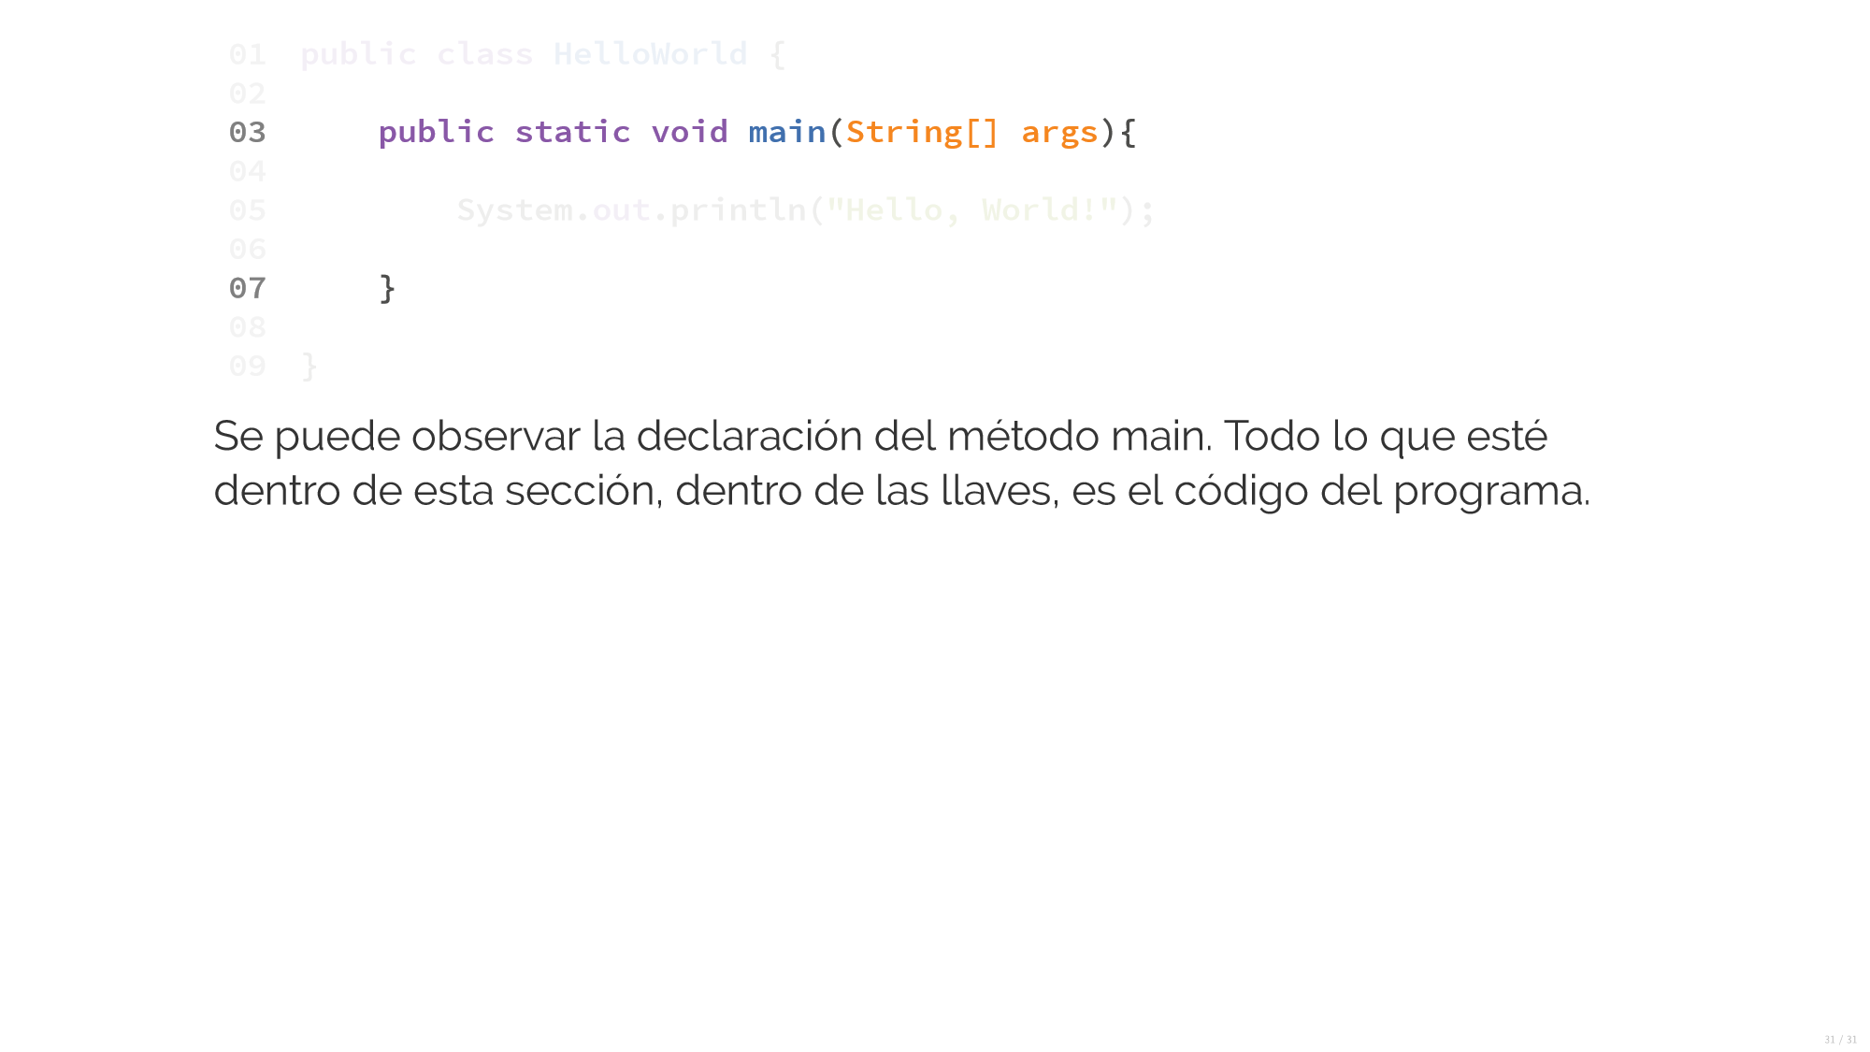
All the code inside the main method will be executed once the program is run.

Slide 26
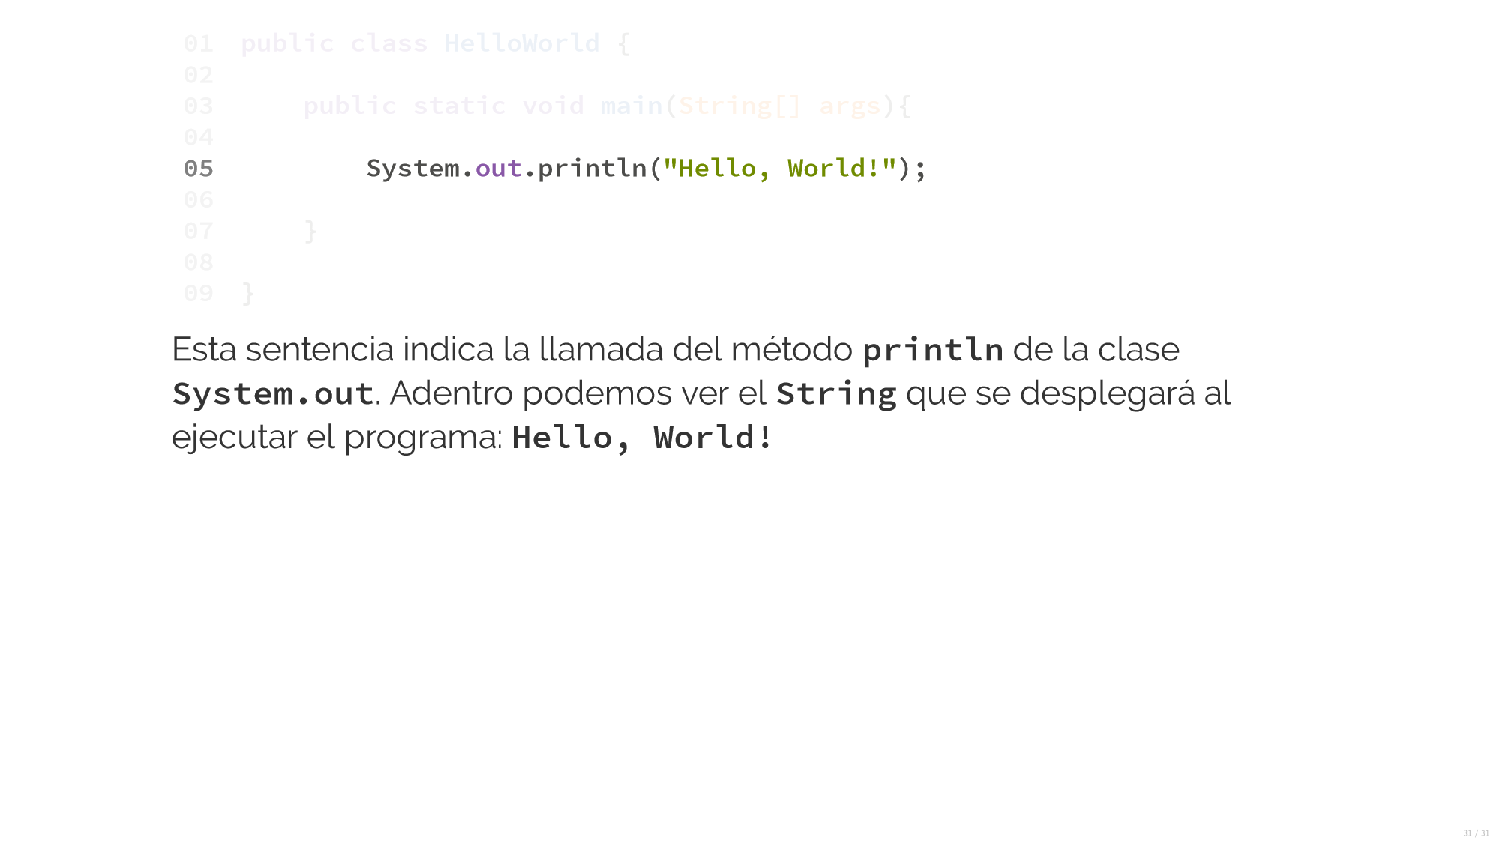
This instruction will print the message “Hello, World” to the output console

